Slide 1
Attention, memory & symmetry
Nick Fisher
@NickFisherAU
19 June 2018

Slide 2

Name the movie…

Slide 3
Language isn’t purely sequential
The trophy could not fit in the suitcase because it was too
Does “it” refers to the trophy or the suitcase?
?
?

Slide 4
Deep learning for sequence prediction still very successful
Language modelling
given a sequence of tokens, predict the next token
The cat sat on the _____
Machine translation
Given a sequence of English tokens, predict the corresponding sequence of French tokens
I don't like video assisted referee
Je n'aime pas l'arbitre assisté par vidéo
INPUT
INPUT
PREDICTION
PREDICTION

Slide 5
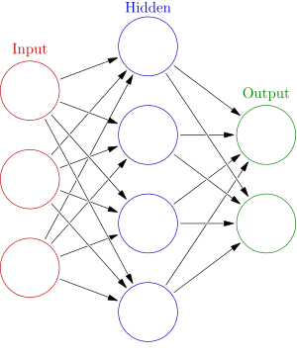
Vanilla neural network unsuited to sequence prediction
Cannot be applied recurrently to each timestep in the sequence
The
cat
sat
on
Backpropagation through time
Backpropagating error “through time” causes gradients to vanish or explode over long time lags
nothing can be learned
numerically unstable

Slide 6
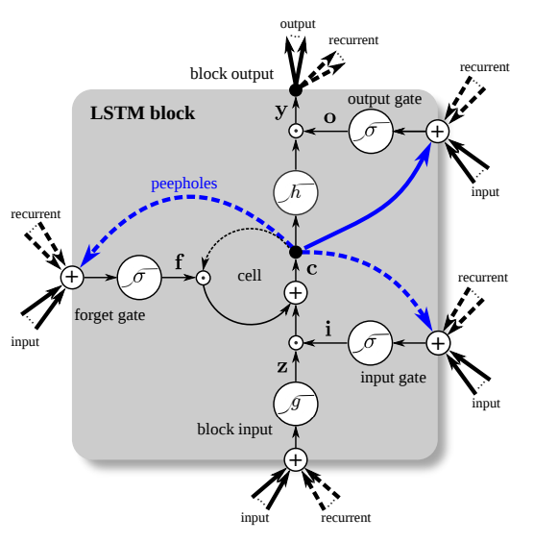
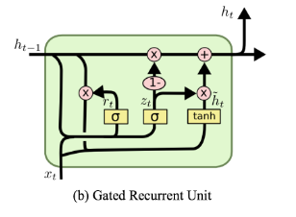
Need to ensure constant error flow back through time
Explicit state + input/output gating
LSTM
https://arxiv.org/pdf/1503.04069v1.pdf
GRU
https://isaacchanghau.github.io/post/lstm-gru-formula/

Slide 7

LSTM + variants very successful
But!
Explicit dependency on (t-1) means cannot parallelize
Long-range dependencies still difficult despite gating
Overweight importance attached to recent time steps vs. further into the past

Slide 8
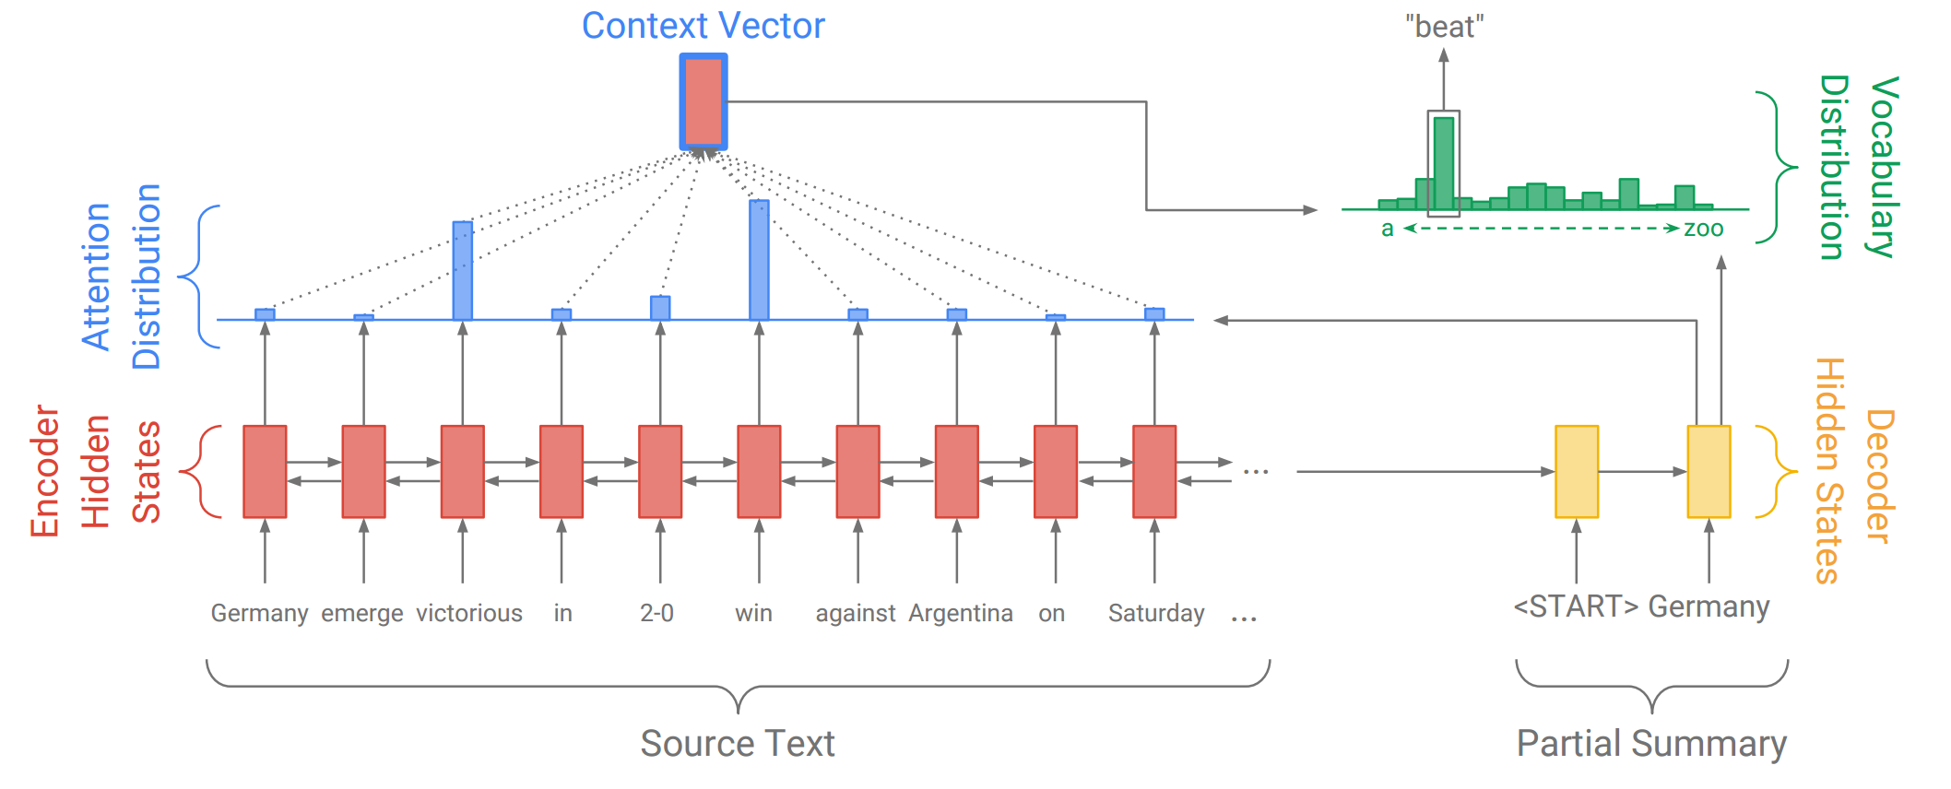
Attention!
Explicitly learn which elements are most important for a given task
E.g. Abstractive summarization
Output a word sequence that summarizes the input sequence
LSTM encoder-decoder model
encoder produces a sequence of state vectors, decoder will (auto-regressively) produce the output sequence
Attention mechanism concurrently learn a context vector over encoder states
When decoding at step t, decoder has access to a (learned) weighted sum of encoder states.
http://www.abigailsee.com/2017/04/16/taming-rnns-for-better-summarization.html

Slide 9
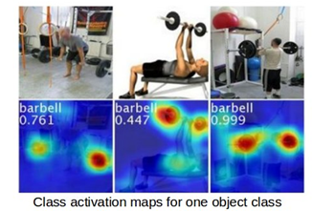
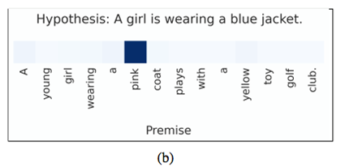
Other examples
Entailment
In deciding if the hypothesis is true, what words were most important?
Visual
In classifying this image, where did I look?
http://cnnlocalization.csail.mit.edu/

Slide 10
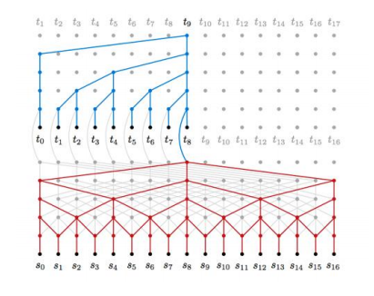
Why?
Attention+LSTM shortens pathways for longer range dependencies
Convolutional neural networks achieve similar effect via pooling/dilations
Maximum path length O(log_{k}(n)) vs O(n) for RNN
Parallelizable & lower parametrization = faster training
https://nlp.stanford.edu/seminar/details/lkaiser.pdf

Slide 11
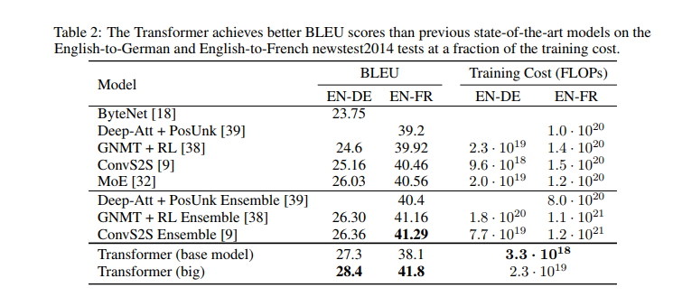
Self-attention
Constant path length between positions
The output at “time-step” t is a weighted average of inputs at every other input “time-step”
Mimics Arrival? Maybe – either way, it works..
Google’s Transformer
Stacked multi-head self-attention
SOTA translation results in a fraction of training time
Includes other neat tricks – sinusoidal positional embeddings, left padding to preserve auto-regressive decoding

Slide 12
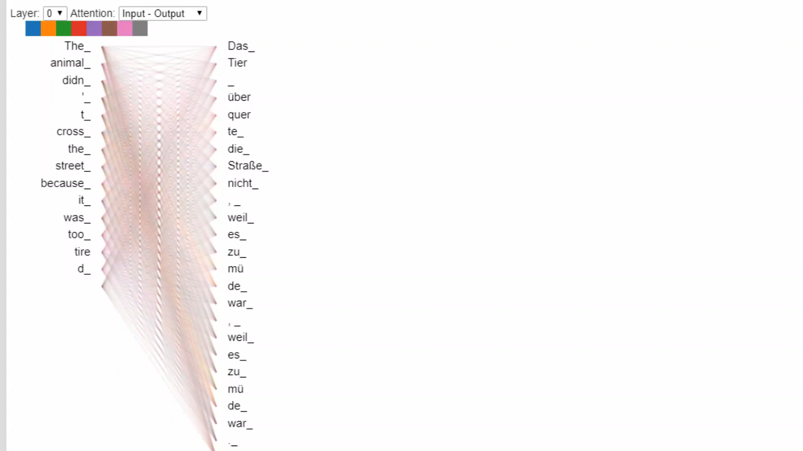

Slide 13
Attention as memory addressing
Input
“External” Memory
Register 1
WRITE
-0.1 0.2 1.8 … 99.1
Register 2
Network
71.0 -34.1 0.01 … -25.5
READ
Register 3
1.95 4.98 -12.22 … 13.0
…..
Output
Learnable attention weights for “soft” read/writes

Slide 14
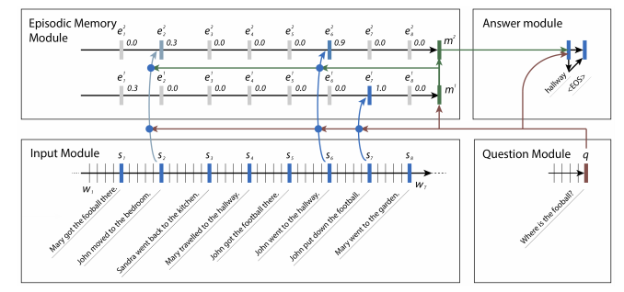
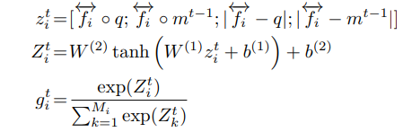
Dynamic Memory Networks
(Slightly simplified), encoder produces fixed-length vector for each ‘fact’ in a sequence of sentences.
Compute an attention gate (scalar for each ‘fact’)
Softmax over activation of product of attention weights, question encoding and episodic memory.
“Context vector” – weighted combination of facts and question encodings – used to produce answer
Ask Me Anything: Dynamic Memory Networks for Natural Language Processing
Ankit Kumar, Peter Ondruska, Mohit Iyyer, James Bradbury, Ishaan Gulrajani, Victor Zhong, Romain Paulus, Richard Socher
https://arxiv.org/pdf/1506.07285.pdf

Slide 15
Many others
Pointer Networks
Differentiable Neural Computer
Hierarchical Attentive Memory
30 minutes not enough to do justice
“Attention Is All You Need” (?)
Next – lightning summary of work by Robert Gens, Pedro Domingos, Chloe Kiddon
“Deep Symmetry Networks” - https://homes.cs.washington.edu/~pedrod/papers/nips14.pdf
https://www.youtube.com/watch?v=xF5FwDAVSPQ
“Symmetry-Based Semantic Parsing” - https://homes.cs.washington.edu/~pedrod/papers/sp14.pdf

Slide 16
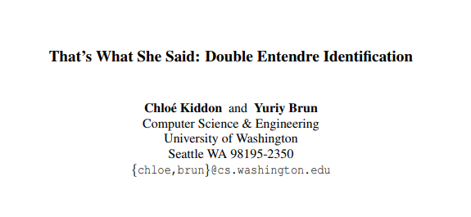

Slide 17
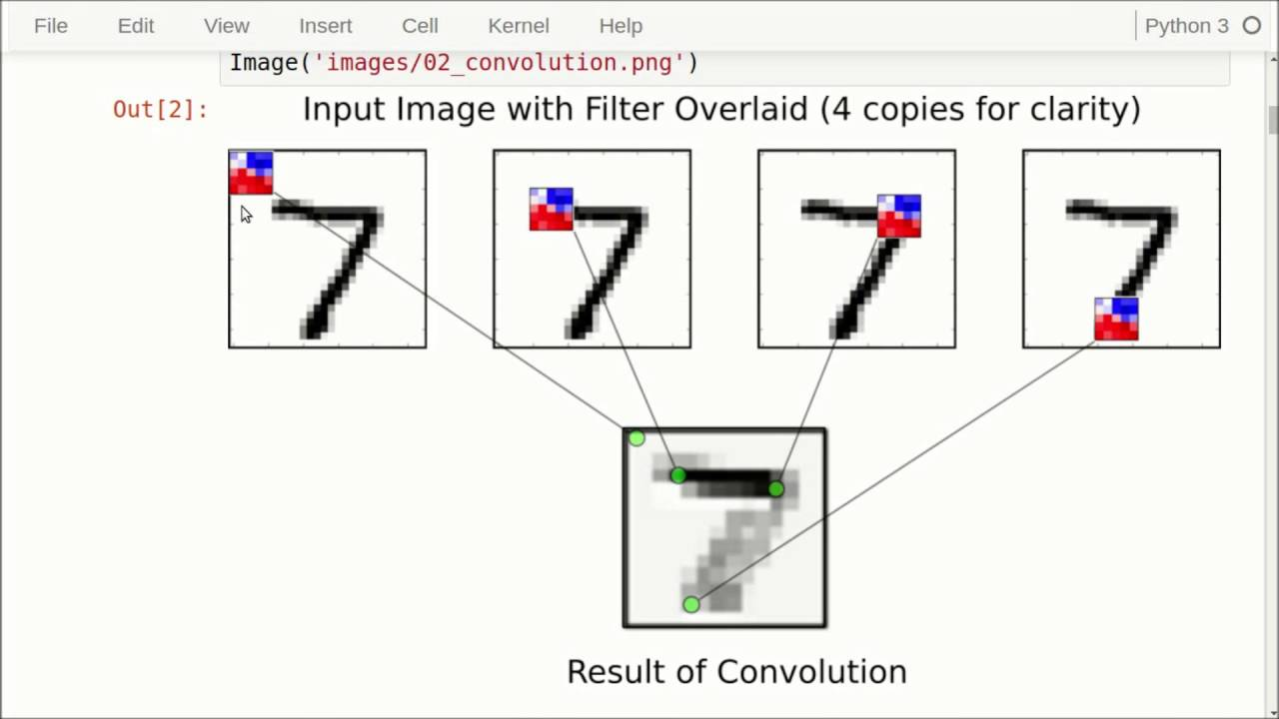
Symmetry-based learning
Returning to convolutional networks
Learn classification task by passing a local 2D filter across width/depth of an image
If we move the image left/right/up/down the filter will still convolve across same local space
Filter will still ‘see’ the exact same window of pixels at the top edge of the
Translation invariant
https://www.youtube.com/watch?v=HMcx-zY8JSg

Slide 18

If we rotate the image, the filter window sees an entirely different alignment of pixels
CNN is not rotation-invariant
Network must learn these explicitly by manually augmenting/perturbing training inputs

Slide 19
How can we recognize that a rotated 7 is still a 7?
Do we explicitly learn from 1000s of slightly rotated examples? Possible…
Or did we learn an underlying representation invariant to certain transformations?
If applying an object to an action returns the same object, that action forms part of the symmetry group
Geometric symmetry - a transformation that maps an object to itself
A square is still a square if we reflect about each axis, or we rotate through 90/180/270/360 degrees.
These form the symmetry group of a square
Set of functions that can be composed with closure, associativity, identity and invertibility

Slide 20
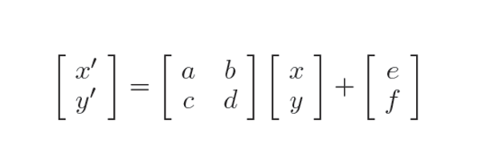
CNN is a “Deep translation network”
filter function + translation symmetry
What about filter function + affine symmetry?
Rotation
Translations
Scaling
Shearing
Reflection
Lie groups – continuous symmetry groups forming a smooth differentiable manifold
Gradient-based optimization can be used to estimate symmetries

Slide 21
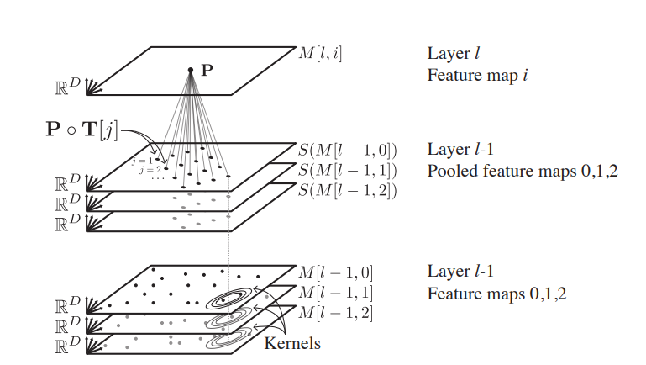
Objective is to learn the orbit of an object
set of objects obtained by applying each element of a symmetry group to x
Apply subset of transformations to input
Symmetry space is six-dimensional
Too large to learn entire space
Compute some symmetries, interpolate remainder
Convolve filters over transformed input
Pool/repeat
See also Spatial Transformer Networks

Slide 22
Symmetry-Based Semantic Parsing
Application of symmetry-based learning to discovering the meaning of sentences
Symmetry of a sentence is a syntactic change that doesn’t change meaning
“William wore sunglasses”
“William donned sunglasses”
“Bill wore shades”
Goal - identify the most probable orbit of the sentence
Orbits will partition the language
Compositional structure - probability distributions
Learnable with Sum Product Networks?
Pathway to logical inferencing?

Slide 23
Thank you!

